Slide 1
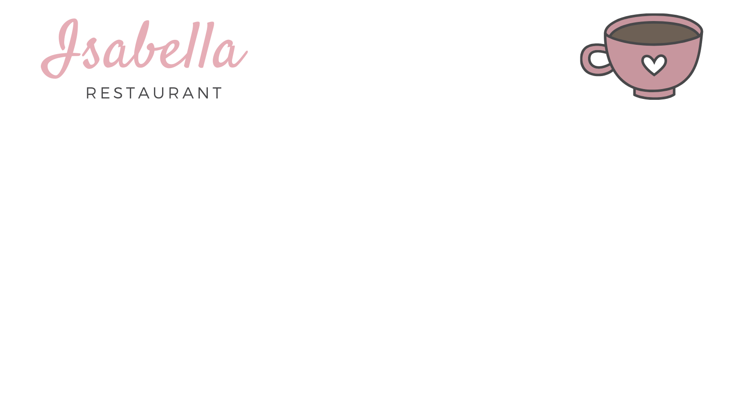

Student name: Rita Lima Student Number: A00267386
Project Title: Website Restaurant
With QR Code

Slide 2


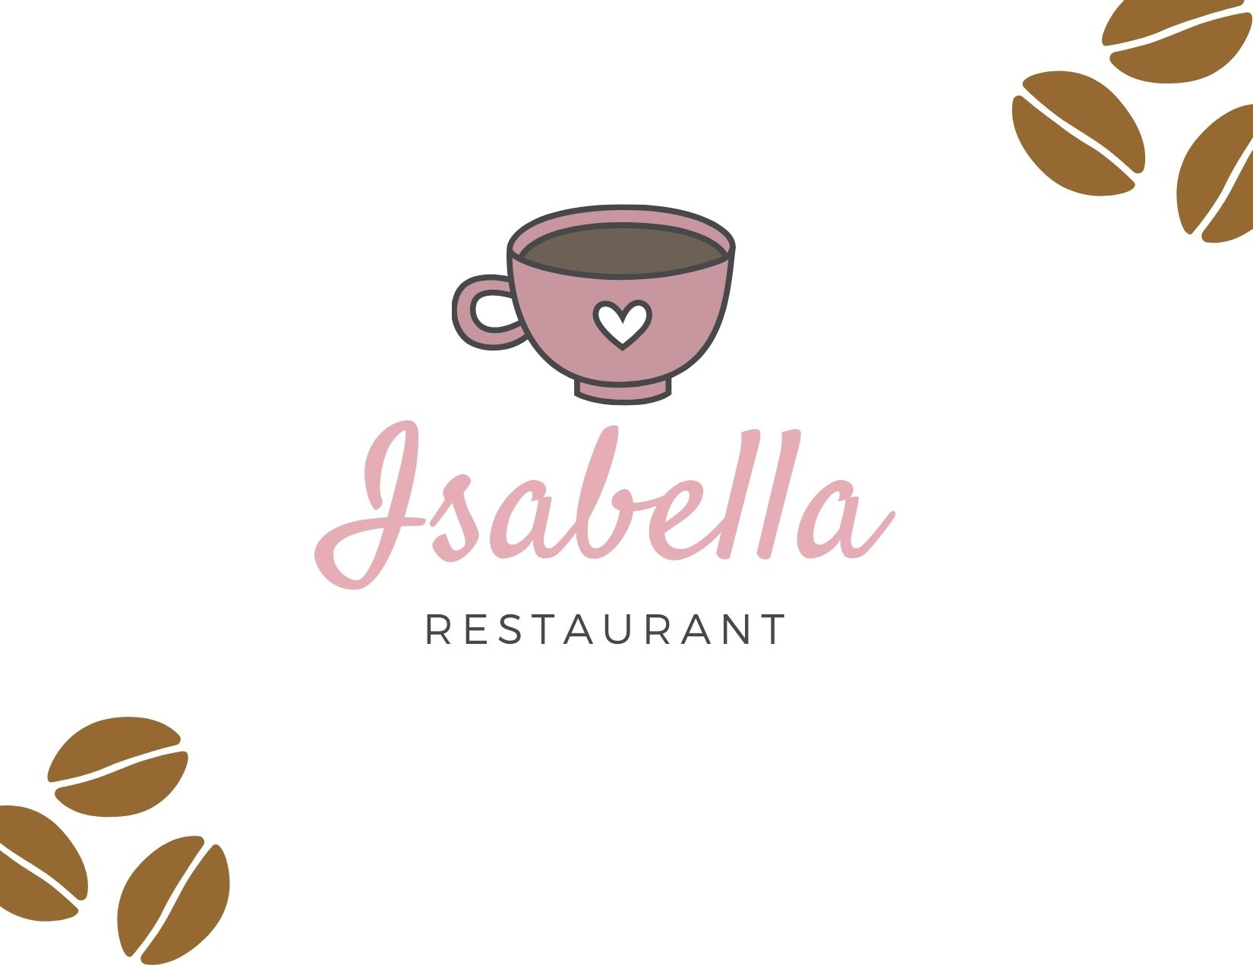
Project Context
Our System provides a web application accessed by restaurants customers scanning the code on the table where they can check the menu and order and restaurant owners able to customize on their menu at any time.

Slide 3
Project Proposal
This project is a restaurant application and has been developed to meet the needs of a simple restaurant. The customer who comes to the restaurant can see menu the QR Code from the mobile phone on the table when the customer scan it.

Slide 4
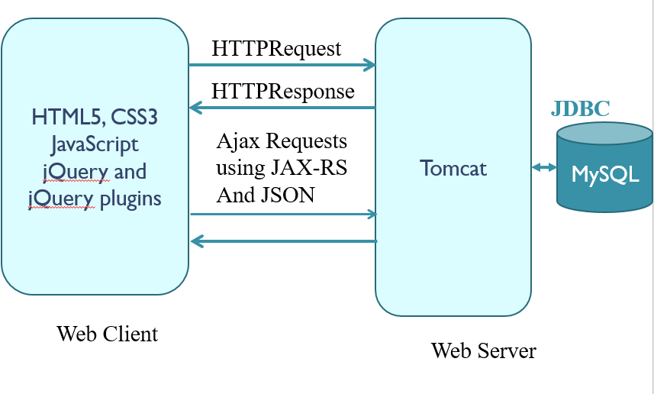
Project Architecture
QR Code

Slide 5
Sprint Goal
Items with the highest priority decided by should be developed first. The main goal is to develop a working website with REST API ajax responses getting all data from the database and is displayed in an interface made up of HTML, CSS and jQuery.

Slide 6
Backlog
USER STORY ELABORATION
User story | Given | When | Then | Pass Fail
No 2. User Login | User enters correct URL | User enters valid username & password and presses Login button. | UserInterface.html appears. | PASS
No 2. User Login | User enters correct URL | User enters invalid username/password and presses Login button. | Login fail' message appears up and number of tries decreases. | PASS
No 2. User Login | User enters correct URL | User leaves empty fields and presses Login button. | Login fail' message appears up and number of tries decreases. | PASS
No 2. User Login | User failed to login correctly 2 times | User enters invalid username/password or empty fields and presses Login button. | Login fail' message appears and number of tires decreases to 0. Username and password fields disable. | PASS
No 2. User Login | User failed to login correctly 2 times | User enters valid username & password and presses Login button. | UserInterface.html appears. | PASS
No 3. User Logout | User is logged on and can see UserInterface.html | User presses Logout button. | LoginForm.html appears. | PASS
No 2. Admin Login | Admin enters correct URL | Admin enters valid username & password and presses Login button. | AdminInterface.html appears. | PASS
No 2. Admin Login | Admin enters correct URL | Admin enters invalid username/password and presses Login button. | Login fail' message appears up and number of tries decreases. | PASS
No 2. Admin Login | Admin enters correct URL | Admin leaves empty fields and presses Login button. | Login fail' message appears up and number of tries decreases. | PASS
No 2. Admin Login | Admin failed to login correctly 2 times | Admin enters invalid username/password or empty fields and presses Login button. | Login fail' message appears and number of tires decreases to 0. Username and password fields disable. | PASS

Slide 7
Database architecture

Slide 8
Definition of Done
User stories have a section that specifies ‘How to test’. The user story can only be considered done when the functionality is fully tested- going by the guidelines specified there. Should consider that testing is completed, before they declare the user story done and starting a new one.

Slide 9
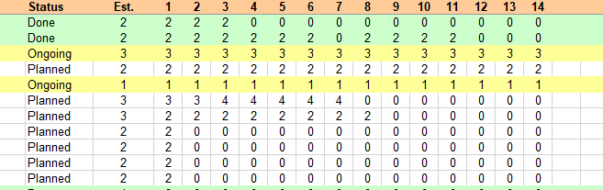
Burn down chart

Slide 10
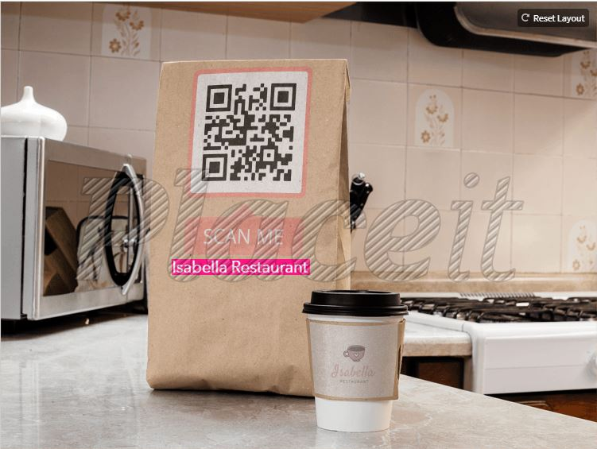
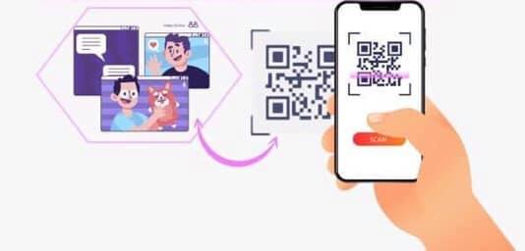
Testing overview

Slide 11
Summary of functionality
Functionality
User QR Code Reader
Menu View
Product View
Staff
Staff Login
Staff Logout

Slide 12
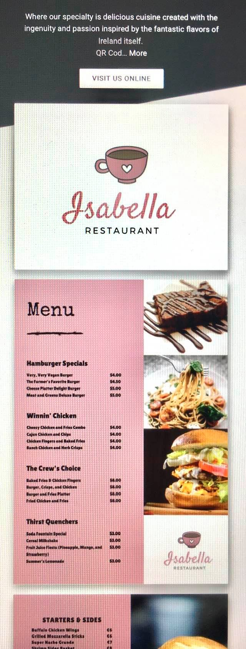
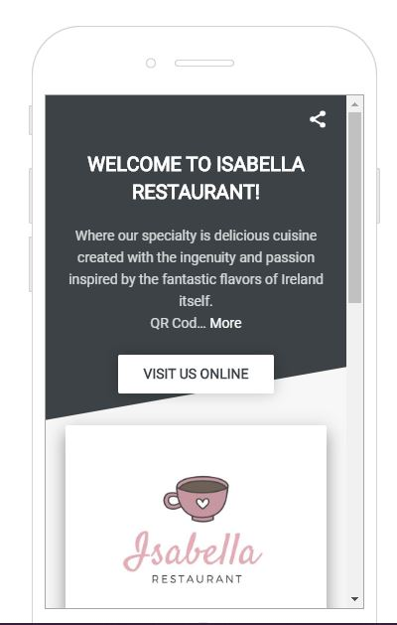
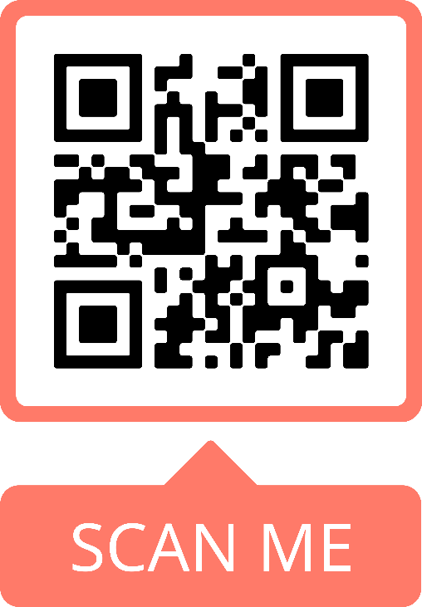
demonstration
Scan QR Code
Simply scan the QR code using your app available on Android and iOS.
Menu Restaurant
QRCode needs a modern HTML5 capable browser and is officially supporting Chrome, Firefox, Safari, Edge and Internet Explorer 11.

Slide 13
Thank you for your time

